Slide 1



MINDSOFYDT
DATA STORM
Golf Pose Analysis

Slide 2



MINDSOFYDT
ABSTRACT
Data science is furthermore being utilised in sports, especially golf. Our team’s idea is to develop a computer vision system that analyzes, evaluates, and assesses a full swing’s technique through provided videos.
Our goal is a tool that helps coaches and athletes pinpoint how they should improve their swing, thereby creating an effective plan.

Slide 3

MINDSOFYDT
4 main phases:
Building an extracted features dataset
MAIN IDEAS AND APPROACH
Defining keypoints based on data
Analysis and real-time visualization
Classifying model training

Slide 4
MINDSOFYDT
STRUCTURE
Pose extractor:
Project’s technical core
Digitalizing videos
Dataset builder:
Automate processing videos
Labeling
Swing definition:
Baseline for comparison
Analysis and visualization:
Measurements and calculations

Slide 5
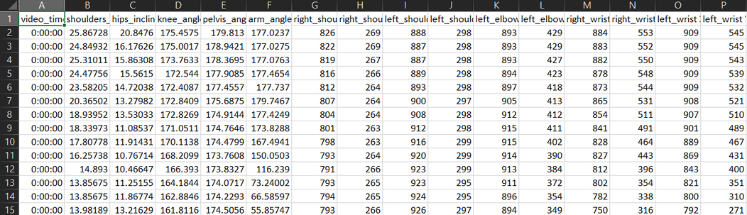
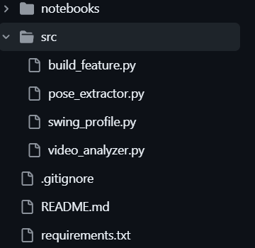
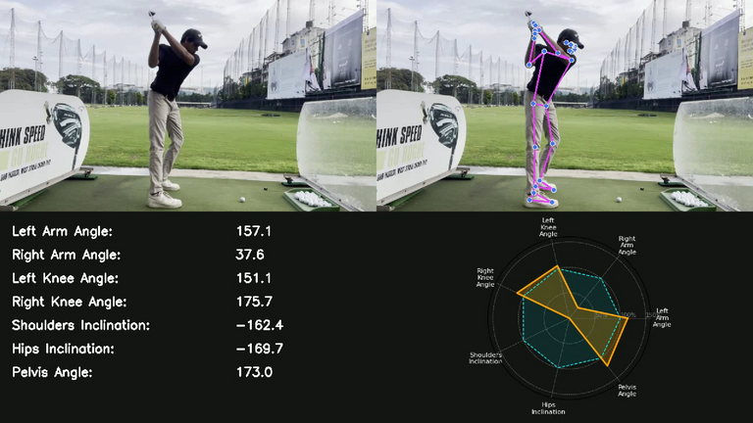
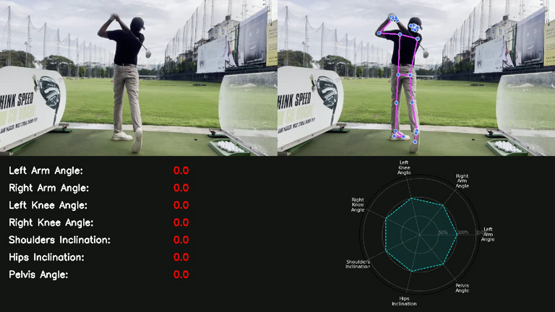
PRELIMINARY RESULTS
Through trials and countless errors, our team has decided and chosen the upcoming video as proof of our best and possible attempt.

Slide 6
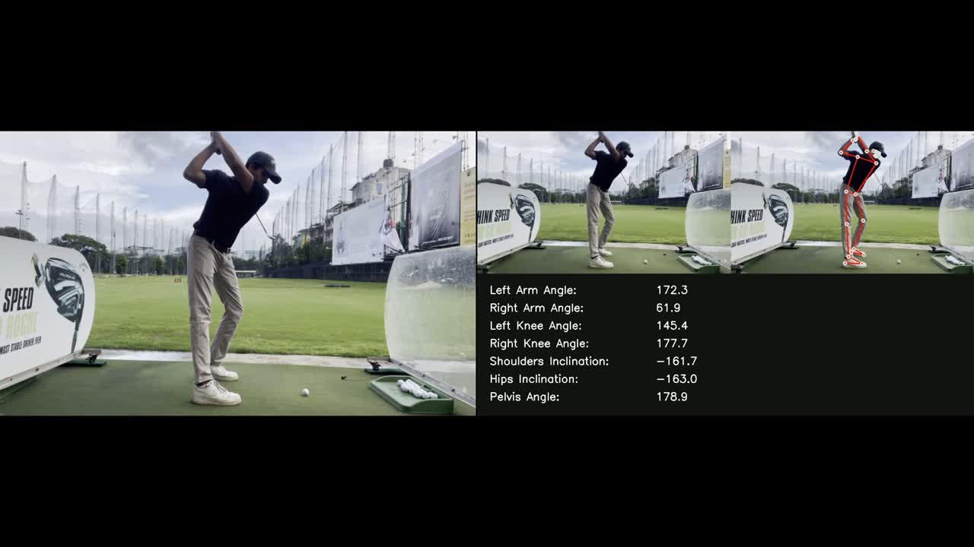
This is the original, and our results side by side. As shown in the video, a skeletal frame is attached to the athlete.

Slide 7

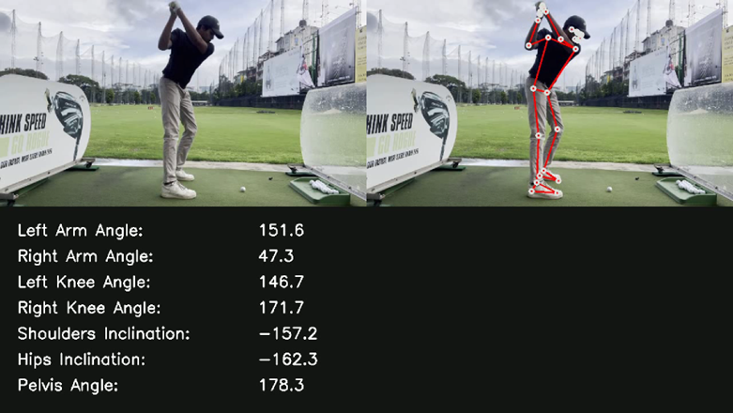

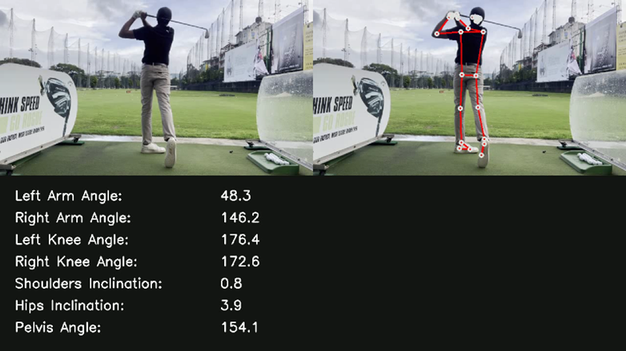

These are screenshots of a full swing’s phases captured, measured, and assessed by our modules.

Slide 8

MINDSOFYDT
THANK YOU
For Your Attention and See You Next Time

